Slide 1
Time Series To infinity and beyond…. by Ralf Martin (r.martin@imperial.ac.uk)

Slide 2
Objectives of this lecture
Time Series data: Different data points represent different points in time
This introduces some additional challenges
We will discuss how to deal with those

Slide 3
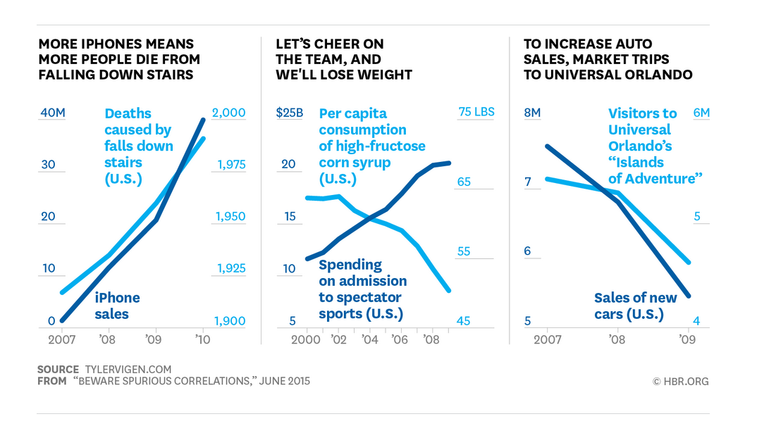
What’s the challenge of time series data?
Can you spot the problem?
Time becomes a confounding variable
Non-stationary: characteristics of data vary with time

Slide 4

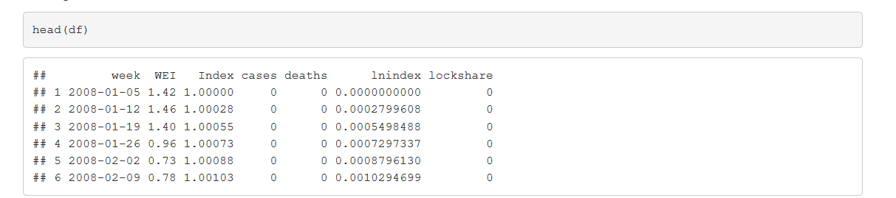
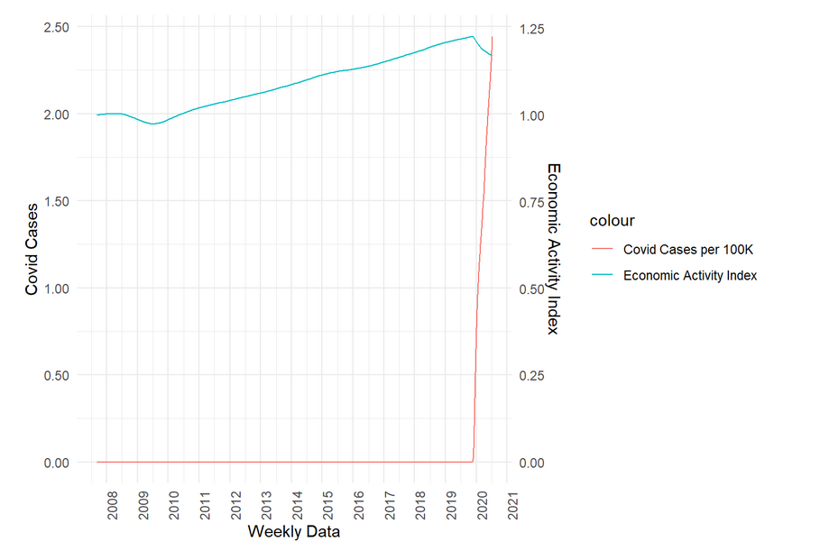
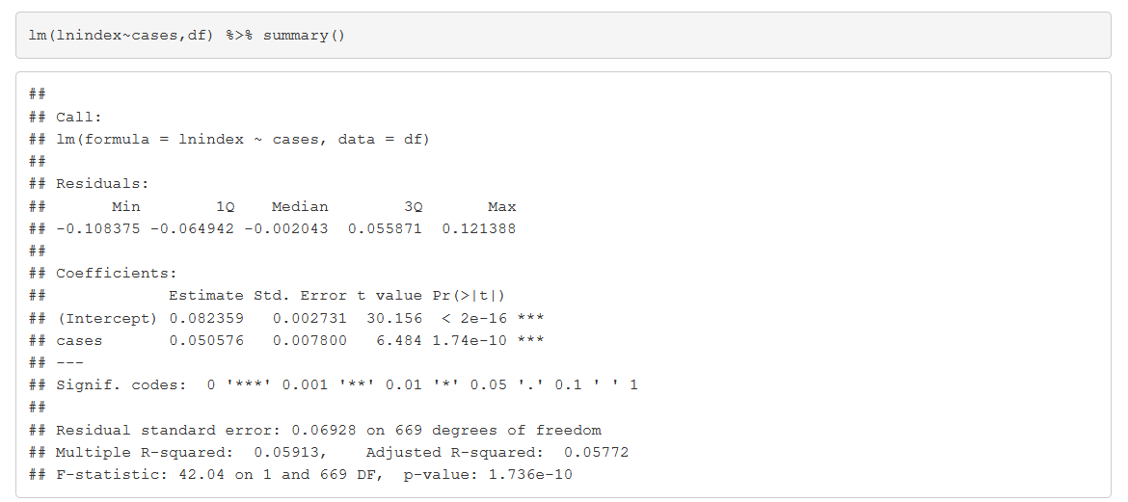
COVID vs GDP
What you think is going to happen?
More COVID = more GDP?
100K more = 5% more GDP?

Slide 5

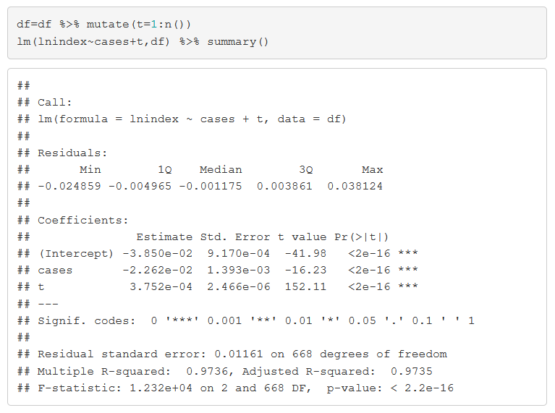
Taking control of time….with a timeline
100k more cases = 2.26% lower GDP

Slide 6
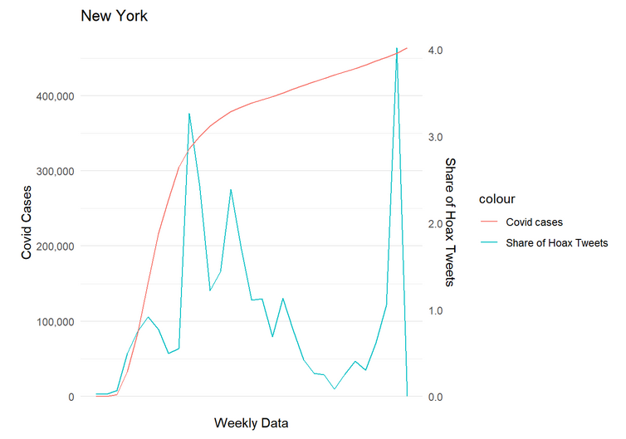
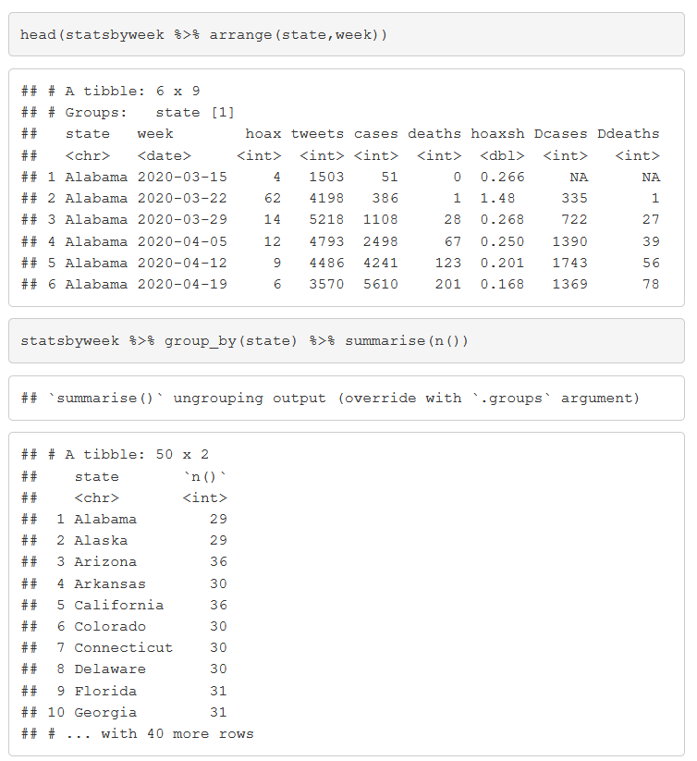
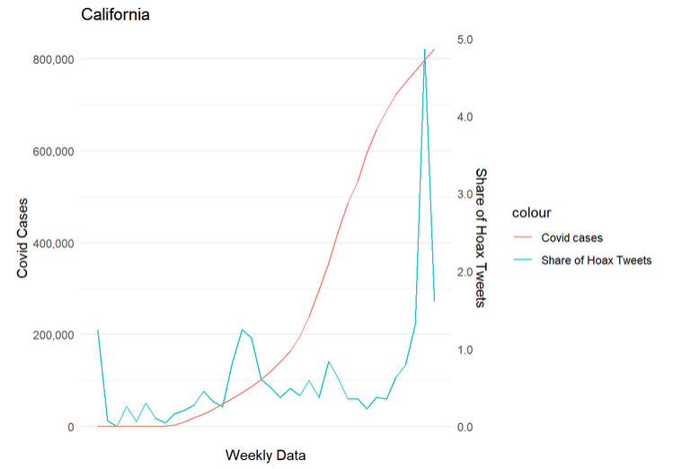
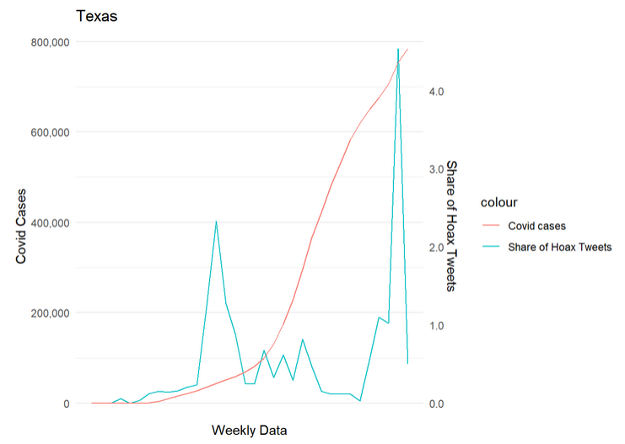
What if time is not linear?
Seasonal effects
Recessions
Natural disasters
Political turmoil
War
Pandemic
Panel data to the rescue
Multiple periods for the same cross section unit

Slide 7
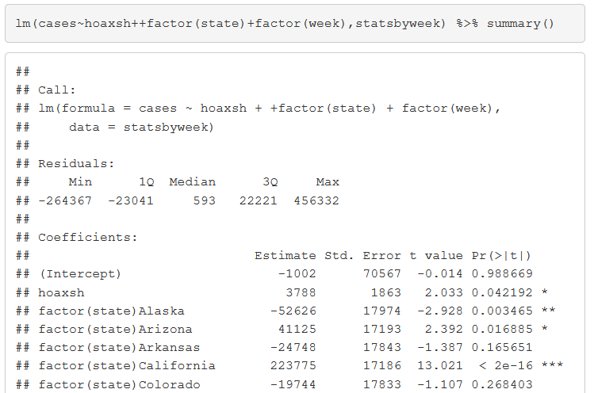
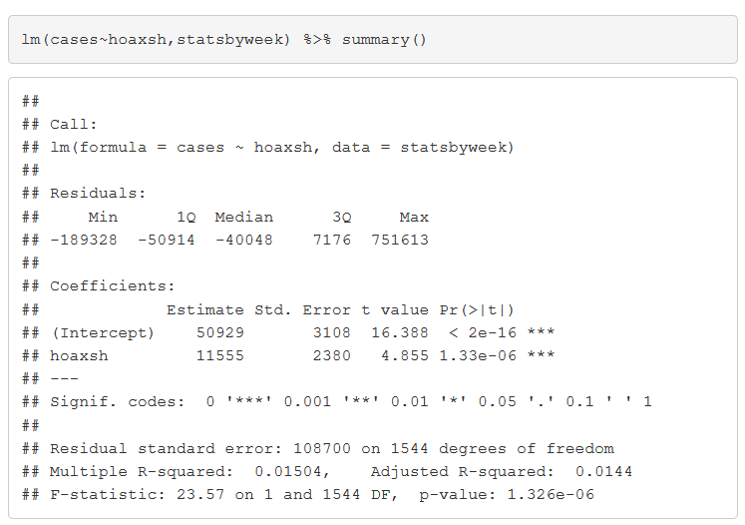
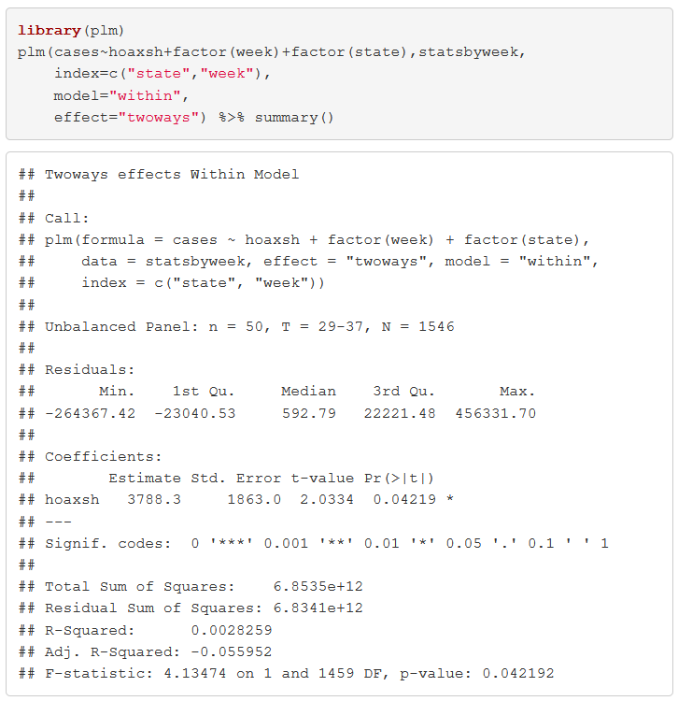
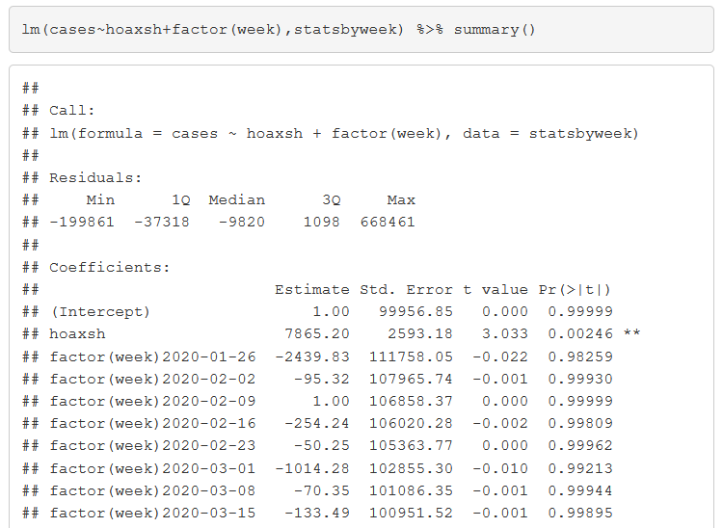
Panel data example
Hoax share up by 1 percentage point means 11555 more cases
Also controlling for state
Alternative command to include cross sectional and time effects in panel data
Substantially more efficient with large datasets (many cross sectional units)
Smaller effect when controlling for time (week) effects

Slide 8
Lags in panel data

Slide 9
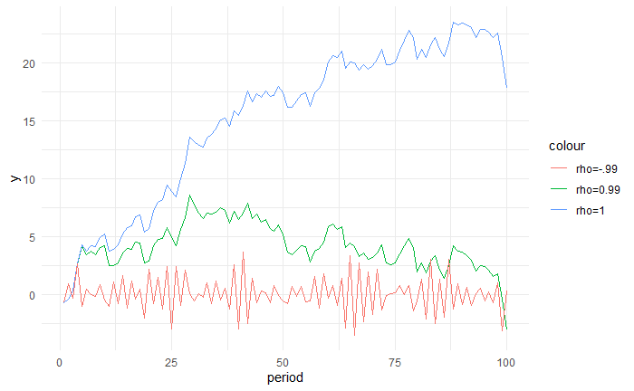

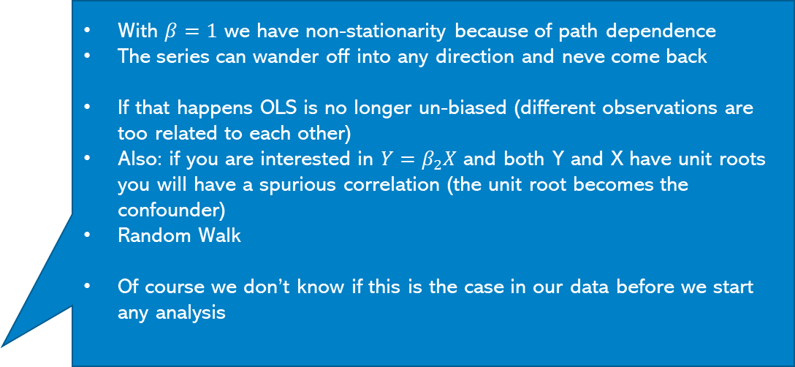
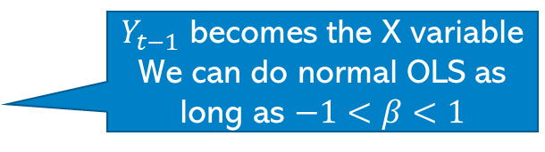
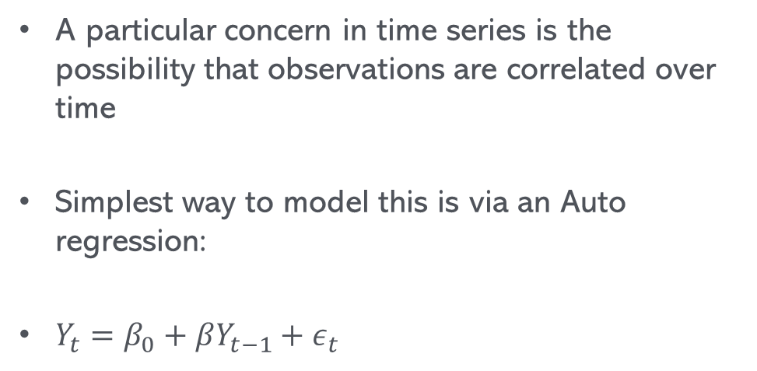
Autoregression
A particular concern in time series is the possibility that observations are correlated over time
Simplest way to model this is via an Auto regression:
$Y_{t}=β_{0}+βY_{t−1}+ε_{t}$
With $β=1$ we have non-stationarity because of path dependence
The series can wander off into any direction and neve come back
If that happens OLS is no longer un-biased (different observations are too related to each other)
Also: if you are interested in $Y=β_{2}X$ and both Y and X have unit roots you will have a spurious correlation (the unit root becomes the confounder)
Random Walk
Of course we don’t know if this is the case in our data before we start any analysis
$Y_{t−1}$ becomes the X variable
We can do normal OLS as long as $−1<β<1$

Slide 10
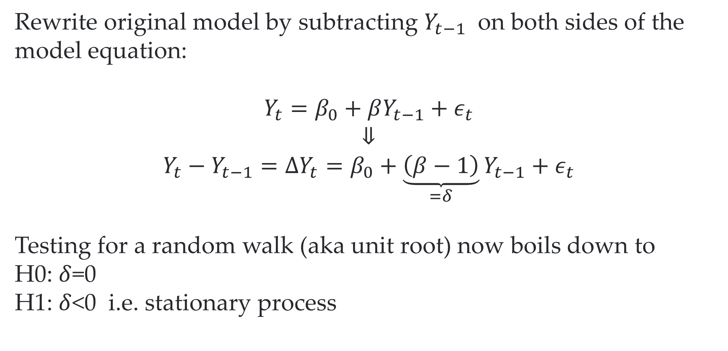
Dickey-Fuller test to the rescue
Rewrite original model by subtracting $Y_{t−1}$ on both sides of the model equation:
$$Y_{t}=β_{0}+βY_{t−1}+ε_{t}$$
⇓
$$Y_{t}−Y_{t−1}=ΔY_{t}=β_{0}+\underset{=δ}{\underbrace{\left(β−1\right)}}Y_{t−1}+ε_{t}$$
Testing for a random walk (aka unit root) now boils down to
H0: $δ$=0
H1: $δ$<0 i.e. stationary process
We cannot just compare the implied test statistic to a normal t-table
Luckily R will help us

Slide 11
Dickey-Fuller with more lags
Rewrite original model by subtracting $Y_{t−1}$ on both sides of the model equation:
$$Y_{t}=β_{0}+βY_{t−1}+ε_{t}$$
⇓
$$Y_{t}−Y_{t−1}=ΔY_{t}=β_{0}+\underset{=δ}{\underbrace{\left(β−1\right)}}Y_{t−1}+ε_{t}$$
Testing for a random walk (aka unit root) now boils down to
H0: $δ$=0
H1: $δ$<0 i.e. stationary process
We cannot just compare the implied test statistic to a normal t-table
Luckily R will help us

Slide 12
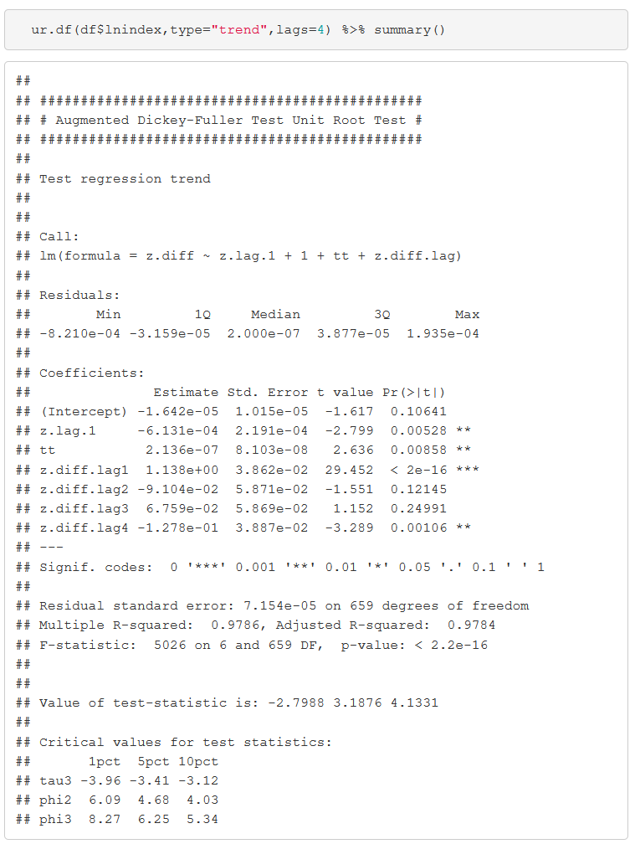
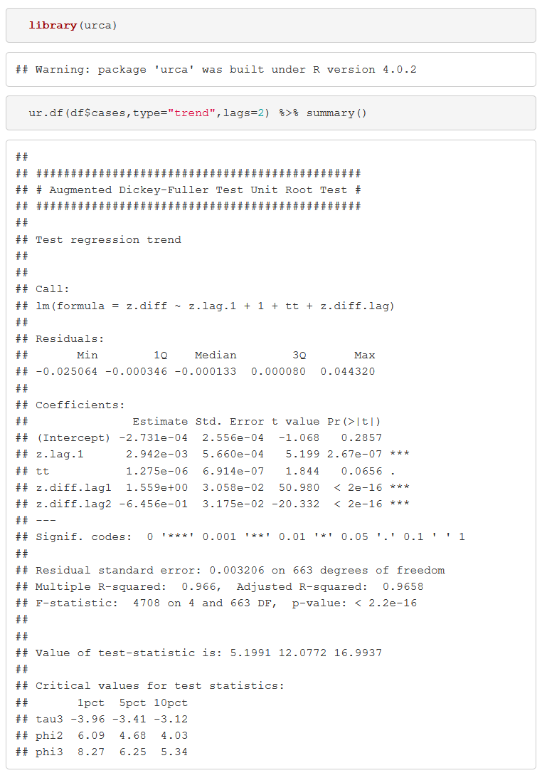
R to the rrrrrescue
We cannot reject unit root becase -2.79>-3.41
We cannot reject unit root becase 5.1991>-3.41

Slide 13

More lags AR(2)?
$$Y_{t}−Y_{t−1}=β_{0}+\left(β_{1}+β_{2}−1\right)Y_{t−1}−β_{2}\left(Y_{t−1}−Y_{t−2}\right)+ε_{t}$$
We can test this again using the coefficient on $Y_{t−1}$
More lags and trend?
$$Y_{t}−Y_{t−1}=β_{0}+\left(β_{1}+β_{2}−1\right)Y_{t−1}−β_{2}\left(Y_{t−1}−Y_{t−2}\right)+ρt+ε_{t}$$

Slide 14
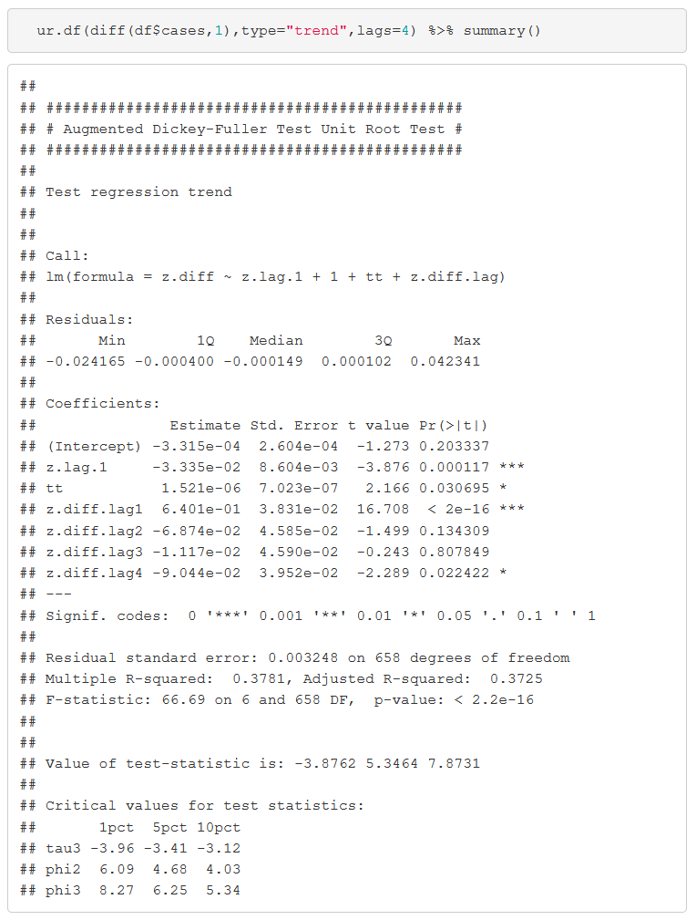
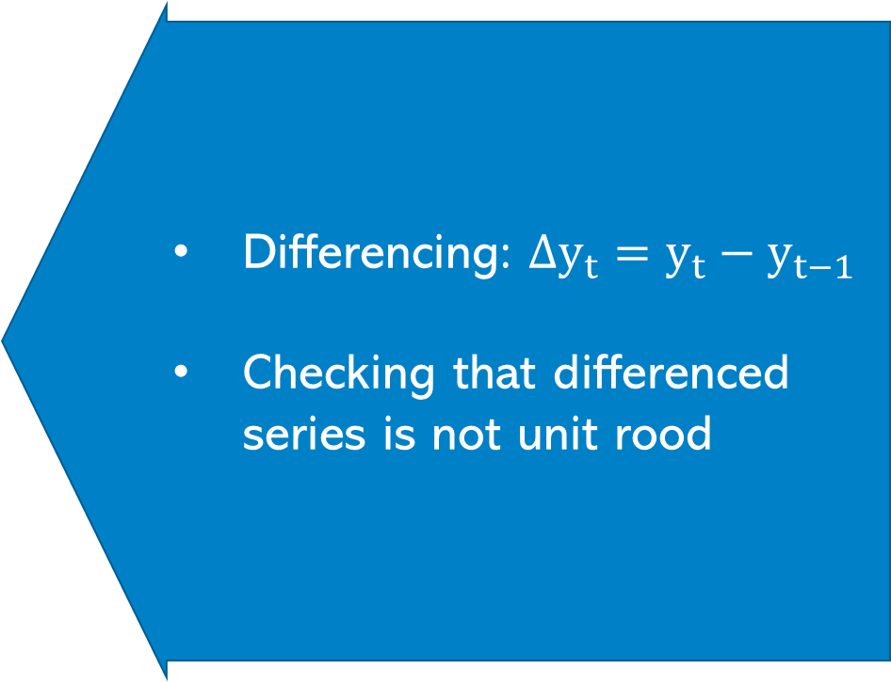
Getting rid of unit roots
Differencing: $Δy_{t}=y_{t}−y_{t−1}$
Checking that differenced series is not unit rood
We cannot reject unit root becase -3.42<-3.87

Slide 15
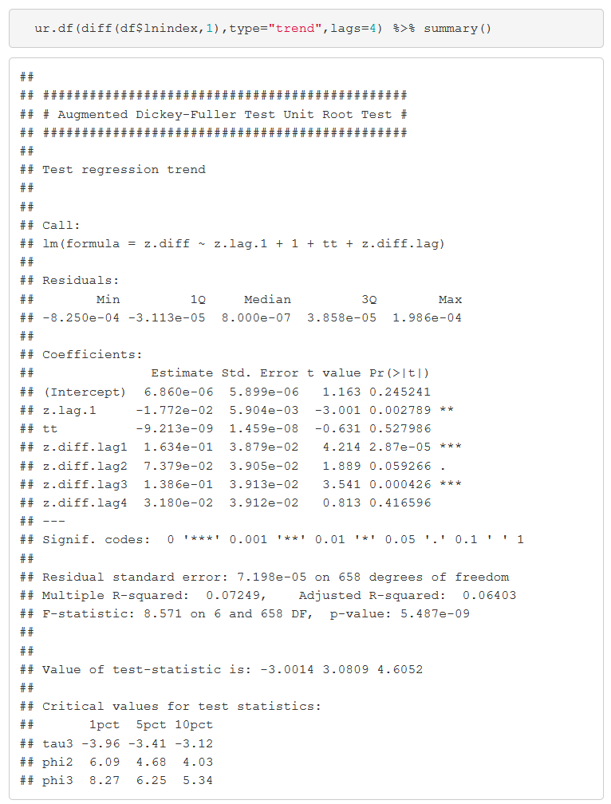
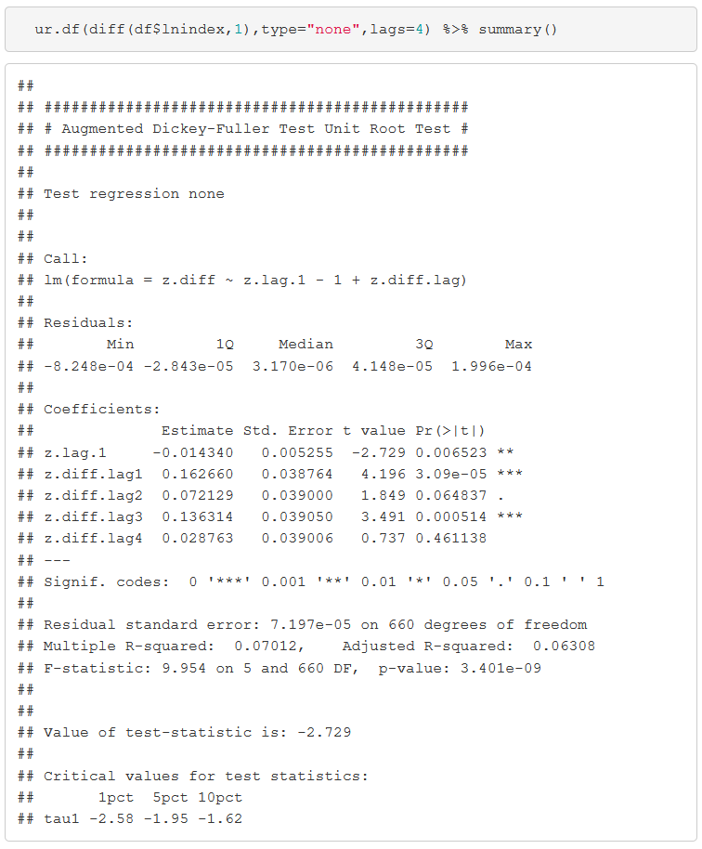
Getting rid of unit roots – Economic Activity index
Now we can reject unit root
Still a unit root?
We cannot reject zero trend either

Slide 16
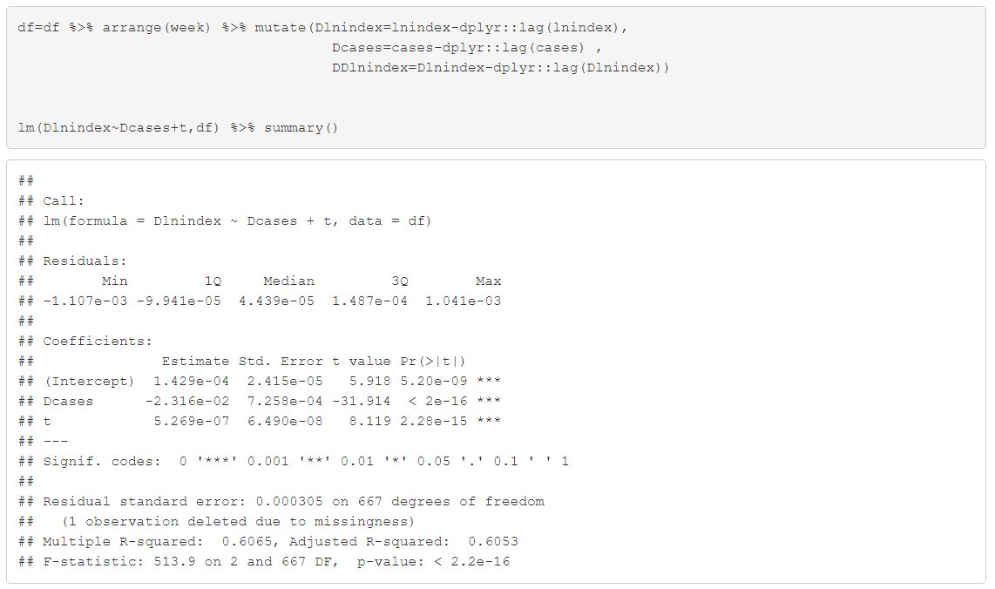
Revisiting COVID vs GDP
100k more cases = 2.3% lower GDP…similar to what we had before….but of course we didn’t know that would happen

Slide 17
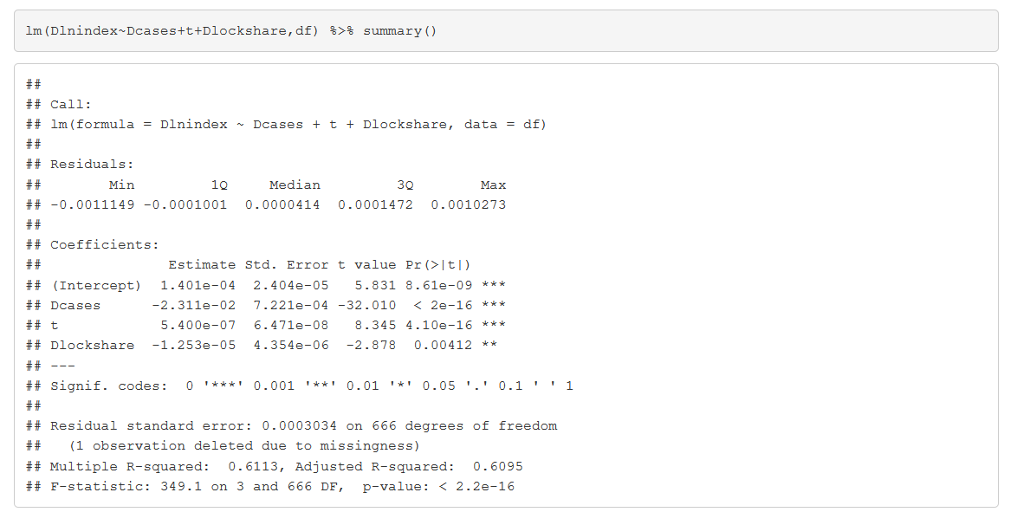
Other considerations
If 100% of US population go into lockdown GDP goes down by -0.138% (seems low..more research needed)

Slide 18
Summary
Time series can be easy
But you need to worry about how stationary your series is
If the series clearly grows or shrinks continuously definitely include a time trend
However, even if it doesn’t grow (or shrink) the series might contain a unit root
If that’s the case a time trend is not enough
Use the Dickey Fuller Test to make sure you are dealing with a stationary series

Slide 19

Extra Slides

Slide 20

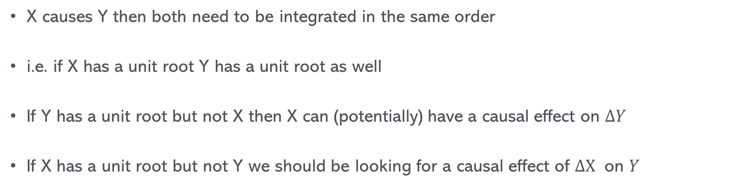
Some remarks on Causality and unit roots
X causes Y then both need to be integrated in the same order
i.e. if X has a unit root Y has a unit root as well
If Y has a unit root but not X then X can (potentially) have a causal effect on $ΔY$
If X has a unit root but not Y we should be looking for a causal effect of $ΔX$ on $Y$

Slide 21
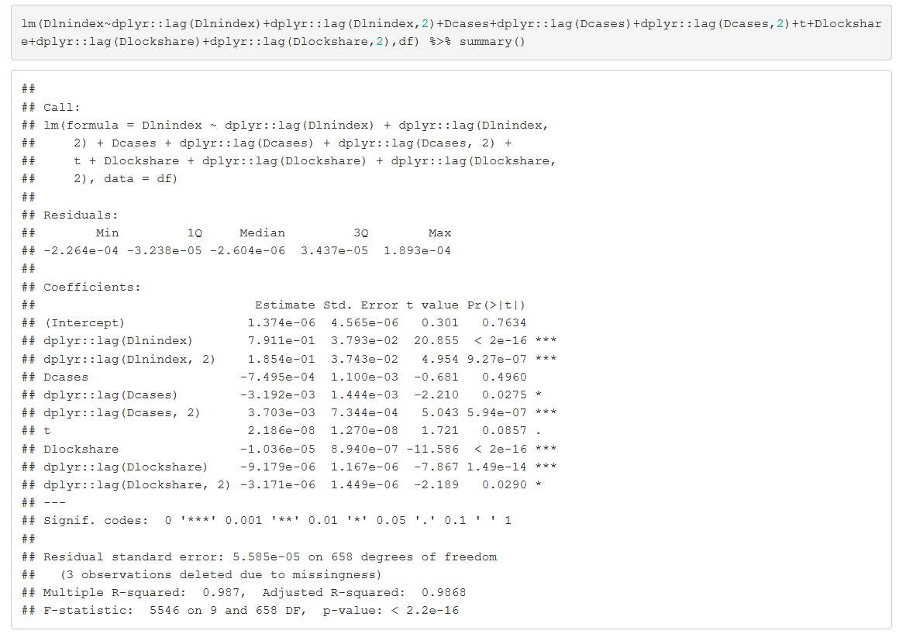
More lags

